Slide 1

CMPE-277-Team Project iOSMarketPlace
Presented by: Ananth Upadhya & Deesha Desai

Slide 2



Introduction
IOS Marketplace is an e-commerce IOS app which ensures an easy and smooth shopping experience
Various third-party integration is done to make the app efficient:

Slide 3
Feature List
Register & Login( Authentication using Firebase)
Categories Listing
Product Listing
Product Detail View
Search products using Algolia
User profile View (Edit profile & Purchase History)
User Cart View
Checkout Order integrated with Stripe for payment

Slide 4
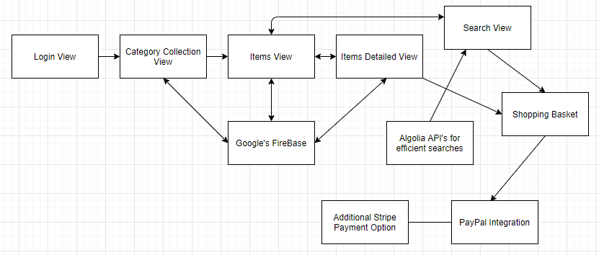
Architecture Diagram

Slide 5
Task Distribution
Ananth Upadhya
Products List
Product Detail
Login & Signup
Search Product
Deesha Desai
Category List
Shopping Cart
Purchase History
Adding Stripe Payment Option

Slide 6
Thank You!

